Slide 1

THEMATIC WEBINAR
LONG ACTING ARVs:
Today and Tomorrow for Treatment and Prevention
VIRTUAL| MAY 27th 2021
Faculty
  Pedro Cahn, Buenos-Aires, Argentina
  Anton Pozniak, London, UK
  François Raffi, Nantes, France

Slide 2
This presentation is made in complete editorial freedom
Thanks to ViiV Healthcare for their institutional support

Slide 3
Disclosure
Pedro Cahn has received research support and/or honoraria for consulting and/or advisory boards from Gilead ; Janssen ; MSD ;
ViiV Healthcare
Anton Pozniak has received research support and/or honoraria for consulting and/or advisory boards from Gilead ; Janssen ; MSD ; Theratechnologies ; ViiV Healthcare
François Raffi has received research support and/or honoraria for consulting and/or advisory boards from Gilead ; Janssen ; MSD ; Theratechnologies ; ViiV Healthcare

Slide 4
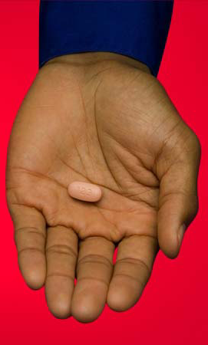
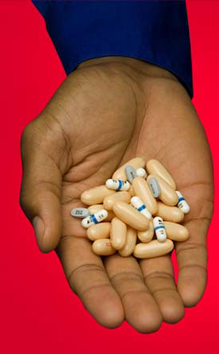
HAART: 25 years of constant progress
1996
2006
+
ATRIPLA®

Slide 5

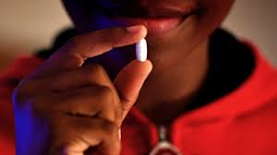

3 drug Oral Fixed-Dose Combinations in 2021
EFV/FTC/TDF
RPV/FTC/TDF
BIC/FTC/TAF
DOR/3TC/TDF
DRV/COBI/FTC/TAF
RPV/FTC/TAF
DTG/ABC/3TC
EVG/COBI/FTC/TAF
EVG/COBI/FTC/TDF

Slide 6
ART issues
Stigmatization associated with drugs intake
Psychological impact linking every day intake and having an incurable infection
Need for life-long treatment
Issues of pill size, of swallowing pills
Risk of non-adherence breakthroughs
Requirement of lifestyle organization (travel, week-ends), to maintain medications
Need for filling prescriptions
Problems in case of discontinuation for any reason (surgery, disruption of drug delivery…)

Slide 7
Challenges associated with daily dosing of HIV medications
Reasons for not sharing HIV status or missing ART in PLWHIV with and without privacy concerns
Never disguised HIV pills in past 6 months to avoid sharing HIV status (N=1006)
Ever disguised HIV pills in past 6 months to avoid sharing HIV status (N=1383)
Missed ART < 5 times in past month from privacy concerns (N=2287)
Missed ART ≥ 5 times in past month from privacy concerns (N=102)
I was worried
about criminal
prosecution
I was worried
about my
physical
safety/potential
violence
I was worried
about being
denied access
to financial
benefits/support
I was worried
about being
denied access
to health care
services
I was worried
I might lose
my job
I was worried
that I might be
excluded from
activities
I was worried
it might affect
my friendships
I was worried
it might affect
my romantic or
sexual relatioships
I was worried
that they would
see or treat me
differently
I was worried
that they might
then disclose
my HIV status
to others
De los Rios P, AIDS Behav 2021;25:961-762

Slide 8
What options?
Sequential treatment interruptions? No, contra-indicated
Later ART initiation (CD4 < 350/mm³)? No, individual benefit, TasP, U = U
5 days on / 2 days off ? Maybe with some regimens (STR with
4 days on / 3 days off ? new INSTI ?), but NOT RECOMMENDED
Reduce drug burden
Long acting regimens

Slide 9
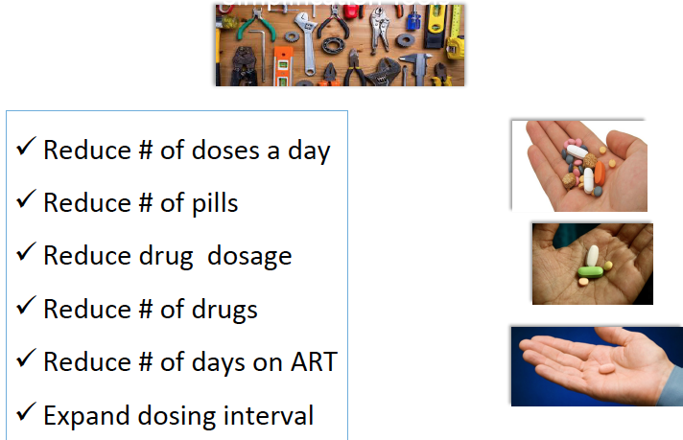
Tools aiming to reduce pill burden
Long-acting regimens
  Freedom from lifelong daily medications
  Low frequency of dosing
  Optimization of PK and decrease
  of inter-individual variability

Slide 10
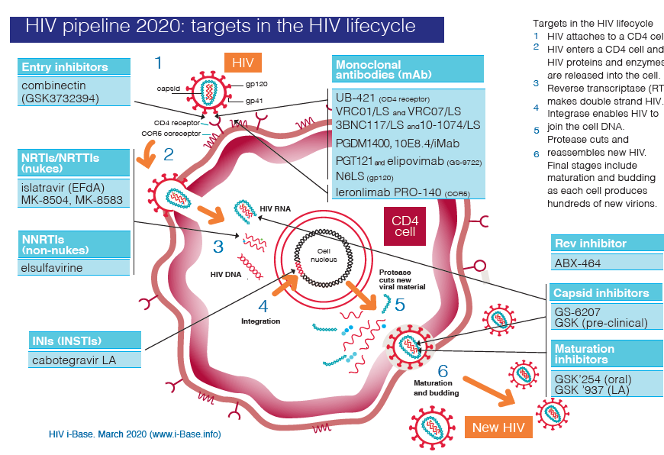
New ARVs in development: High focus on LA
HIV pipeline 2020: targets in the HIV lifecycle
QW
QW
Q6M
QW / QM
Q12M (PrEP)
QM
Q2W oral
Q6M SC
Q2M
Q6M (PrEP)

Slide 11
Benefits of Injectable LA ART Regimen (by Region)
Health Providers Perception
1
0,8
0,6
Proportion
0,4
0,2
0
Europe
North
America
East Asia/
Pacific
Africa
Latin
America
Lifestyle
Convenience
Psychological/emotional
Privacy
Reduce stigma
Reduced side effects
Reduce drug/food interaction
Easy management
Contact with provider
Kerrigan D, IAC 2020, Abs. PEB0260

Slide 12
Barriers to LA ART Appointment Adherence
(by Region) Health Providers Perception
0,8
0,6
Proportion
0,4
0,2
0
Europe
North
America
East Asia/
Pacific
Africa
Latin
America
Travel work/holiday
Time burden
Travel burden
Appointment #
Cost burden
Move out
Instability
Kerrigan D, IAC 2020, Abs. PEB0260

Slide 13
Interest in Long-Acting HIV Regimen: PLWHIV and Physicians Perspectives (Western Europe)
BENEFITS
CONCERNS
HCPs’
perspectives
Q. For you as the treating physician, how important are each of the following benefits of Regimen Z?
Please select one response for each statement. (4-Point Scale [1-Not At All Important, 2-Not Very
Important, 3- Somewhat Important, 4- Very Important]), report for scores ≥3 on the 4 point scale.
Top five listed by HCP Total
Q. As the treating physician, how concerned are you about each of the following constraints of
Regimen Z? Please select one response for each statement. (4-Point Scale [1-Not At All Concerned,
2-Not Very Concerned, 3-Somewhat Concerned, 4- Very Concerned]), report for scores ≥3 on the 4
point scale. Top five by HCP Total.
More frequent
contact with
patients
Removes food
requirements
Route of drug
intake
Easier
management of
concomitant
diseases
Reduced GI side
effects related to
daily oral ART
Time/capacity to
receive patients 6
times/year for injections
Route of drug
intake
Injection site
reactions
Taking a patient
off long-acting
regimen and switching
back to oral ART
Patients missing
their appointments /
sending
reminders
PLWHIV’s
perspectives
Q. What characteristics do you like about Regimen Z? Please select all that apply below.
Top five listed by PLHIV Total
Q. What are the concerns you have with Regimen Z? Please select all that apply below.
Top five by PLHIV Total.
Easier to travel
because of not
having to take
pills along
2-month
uninterrupted
drug efficacy
Reduced
frequency of
drug intake
No risk of missing
a dose, which
minimizes the
risk of treatment
failure
Minimizes
transmission risk
and improves
sexual health
Scheduling travel to
meet the 2-week
injection window
Pain of the
injections
Missing the
2-week
injection window
Making the time
to go to the clinic
every 2 months
Having to travel to
the clinic every 2
months (cost)
Akinwunmi B, HIV Glasgow 2020, Abs P014

Slide 14
CAB LA + RPV LA IM
Cabotegravir
  Integrase inhibitor, structural analogue of dolutegravir
  Oral 30 mg tablet (t_{1/2} ≈ 40 hours)
  IM LA nanosuspension 200 mg/mL (t_{1/2} ≈ 20-40 days)
Rilpivirine
  Oral 25 mg tablet (t_{1/2} ≈ 50 hours)
  IM LA nanosuspension 300 mg/mL (t_{1/2} ≈ 30-90 days)
CAB LA + RPV LA
  Different MOA, resistance profile, metabolic pathways, lack of drug interaction between both ARVs
  Experience with oral DTG/RPV (SWORD study)
  Phase 3 trials support Q4W/Q8W synchronous dosing schedule
  Oral combo formulation for treatment initiation, oral bridging, discontinuation strategies

Slide 15
CAB LA + RPV LA IM
Phase 3 programs for Treatment and Prevention
Indication
Phase 3
Phase 3b
Treatment
(Switch as
maintenance)
FLAIR (N=620)
ATLAS (N=570)
ATLAS 2M
(N=1020)
HPTN 083
(N=4500)
Prevention
MSM/TGW
HPTN 084
(N=3200)
Prevention
Women

Slide 16
FLAIR W96
Screening
Phase
Induction
Phase
Maintenance
Phase
Extension
Phase
N=809
ART naive
HIV-1 RNA ≥1000 c/mL
Any CD4 count
HBsAg-negative
NNRTI RAMs excluded
N=629
DTG/ABC/3TC
single-tablet regimen for
20 weeks
DTG/ABC/3TC
Oral daily N=283
Switch to LA N=232
Oral CAB+RPV N=283
CAB (400 mg)
+ RPV (600 mg)
LA IM monthly N=278
Extension
switch/continue CAB (400 mg)
+ RPV (600 mg)
LA IM monthly N=475
Study Week
−20
−4
Day 1
4
48
96
100
124
Confirm HIV-1 RNA
<50 c/mL
Randomisation (1:1)
Primary
Endpoint
Data
Cut-off
Oral
Lead-In
Analysis
Orkin C, Lancet HIV 2021 April; 8:e185-96

Slide 17
FLAIR W96
%
CAB + RPV LA
DTG/ABC/3TC
100
Adjusted treatment difference (95% CI)*
CAB + RPV LA (N=283)
89,4
DTG/ABC/3TC (N=283)
86,6
80
6%
non
inferiority
margin
LA is noninferior
to DTG/ABC/3TC
(≥50 c/mL) at
Week 96
- 2.9
0
2.9
60
-10
-8
-6
-4
-2
0
2
4
6
8
10
Difference (%)
DTG/ABC/3TC
CAB + RPV LA
40
20
LA is noninferior
to DTG/ABC/3TC
(<50 c/mL) at
Week 96
10,2
-10%
non
inferiority
margin
3,2
3,2
7,4
- 8,2
-2.8
2.5
0
Virologic non-response
HIV RNA ≥ 50 c/mL
Virologic success
HIV RNA < 50 c/mL
No virologic data
-10
-8
-6
-4
-2
0
2
4
6
8
10
Difference (%)
Orkin C, Lancet HIV 2021 April; 8:e185-96

Slide 18
Long-Acting Injectable cabotegravir + rilpivirine for HIV
Maintenance Therapy: Week 48 Pooled Analysis of Phase 3 ATLAS and FLAIR Trials
Pooled efficacy outcome, ITT-E snapshot
Outcome | LA, N=591 N (%) | CAR, N=591 N (%) | Adjusted Difference, % (95% CI) | NI margin
HIV-1 RNA < 50 copies/mL at week 48* (key secondary endpoint) | 550 (93.1) | 558 (94.4) | - 1.37 (- 4.12 to 1.39) | -10
HIV-1 RNA ≥ 50 copies/mL at week 48* (primary endpoint) Data in window not below threshold Discontinued for lack of efficacy Discontinued for other reason while not below threshold Change in background therapy | 11 (1.9) 3 (0.5) 7 (1.2) 1 (0.2) 0 | 10 (1.7) 3 (0.5) 5 (0.8) 2 (0.3) 0 | 0.16 (- 1.35 to 1.67) | 4
No virologic data Discontinued study because of AE or death Discontinued study for other reasons On study but missing data in window | 30 (5.1) 19 (3.2) 11 (1.9) 0 | 23 (3.9) 7 (1.2) 16 (2.7) 0
CAR = Standard oral cART (ATLAS), N=308 ; ABC/3TC/DTG (FLAIR), N=283
Rizzardini G, JAIDS 2020;85:498-506

Slide 19
ATLAS 2M – Design
CAB LA + RPV LA Q4W vs Q8W
Screening Phase
Maintenance Phase*
Extension Phase
391† ATLAS phase 3 study
(cabotegravir plus
rilpivirine LA every
4 weeks)
Oral
cabotegravir
plus rilpivirine
Except
participants
from ATLAS
already on LA
therapy
522 every 8 weeks cabotegravir (600 mg)
plus rilpivirine (900 mg) LA
Randomly
assigned
1:1‡
Option to continue randomized
cabotegravir plus rilpivirine LA
every 4 weeks or every 8 weeks at
week 100
654 † ATLAS standard-of-care
group + additional
standard-of-care
Participants§: protease
inhibitor, NNRTI, or
INSTI-based regimen
with 2 NRTI backbone
523 every 4 weeks cabotegravir (400 mg)
plus rilpivirine (600 mg) LA
Primary endpoint
Day 1
W4
W48
W96
W100
Overton ET, Lancet 2020 Dec 19;396:1994-2005

Slide 20
ATLAS 2M – W96 results
%
Virologic outcomes at W96 – ITT-E snapshot
Q4W
Q8W
100
HIV RNA > 50 c/mL at W96
Q8W CAB + RPV LA
(N=522)
91.0
90.2
80
Q4W CAB + RPV LA
(N=523)
1.0
4%
non inferiority margin
- 0.6
2.5
60
-10
-8
-6
-4
-2
0
2
4
6
8
10
Difference (%)
Q4S
Q8S
40
HIV RNA < 50 c/mL at W96
20
6.0
8.6
- 2.8
0.8
4.3
2.1
1.1
-10%
non inferiority
margin
0
Virologic non-response
HIV RNA ≥ 50 c/mL
Virologic success
HIV RNA < 50 c/mL
No virologic data
-10
-8
-6
-4
-2
0
2
4
6
8
10
Difference (%)
Jaeger H, CROI 2021, Abs. 401

Slide 21
ATLAS 2M – Injection site reactions
Injection site reactions
100
Every 8 weeks group
Every 4 weeks group
80
60
Participants with
injection site reactions (%)
Primary endpoint
40
20
0
Day 1
4
8
12
18
20
24
28
32
36
40
44
48
52
Time (week)
Partcipants at visit
Every 8 weeks group
Every 4 weeks group
194
196
321
515
514
515
NA
513
511
508
NA
502
502
503
NA
502
496
499
NA
492
495
491
NA
490
493
488
NA
476
Overton ET, Lancet 2020 Dec 19;396:1994-2005

Slide 22
CB LA + RPV LA
Pooled analysis of confirmed virologic failures, resistance emergence at failure, and discontinuations for AE
 | ATLAS-2M W96 ¹ |  | FLAIR W96 ² |  | ATLAS W48 ³
 | Q8W N=522 | Q4W N=523 | Q4W N=283 | DTG/ABC/3TC N=283 | Q4W N=308 | CAR N=308
CVF * | 9 (1.7 %) | 2 (0.4 %) | 4 (1.4 %) | 4 (1.4 %) | 3 (1 %) | 4 (1.3 %)
HIV-1 sub-type |  |  | A1 = 3 |  | A1 = 2, AG = 1
CVF with RPV mutations RPV mutations at failure | 7/9 K101E, E138E/K, E138A, Y188L,Y181C | 1/2 K101E, M230L | 3/4 K101E E138/E/A/K/T E138K | NA | 1/3 E138E/K | Emergence of NRTI mutations in 3/4
CVF with INSTI mutations INSTI mutations at failure | 5/9 Q148R, N155H | 2/2 E138E/K, Q148R, N155N/H | 3/4 G140R Q148R (2) | 0 | 1/3 N155H | 0
Discontinuations for AE | 18 (3.4 %) | 19 (3.6 %) | 12 (4 %) | 4 (1 %) | 14 (4.5 %) | 5 1.6 %)
Discontinuations for ISR | 7 (1.3 %) | 11 (2.1 %) | 6 (2.1 %) | NA | 4 (1.3 %) | NA
* CVF = Confirmed virologic failures (CVF) = 2 consecutive HIV RNA ≥ 200 c/mL
1. Jaeger H, CROI 2021, Abs. 401 ; 2. Orkin C, Lancet HIV 2021 April;8:e185-96 ;
3. Rizzardini G. JAIDS 2020;85:498-506

Slide 23
CAB LA + RPV LA IM
Indication and Practical questions
EMA approval / FDA approval (Cabenuva®)
  CAB LA (Vocabria®) IM + RPV LA (Rekambys®) IM indicated for the treatment of HIV-1 infection in adults (to replace current ART) who are virologically suppressed (HIV RNA <50 cp/mL) on a stable ART without present or past evidence of viral resistance to, and no prior virological failure with agents of the NNRTI and INI class (with no history of treatment failure and with no known or suspected resistance to CAB or RPV)
  Oral lead-in CAB 30 mg qd + RPV 25 mg qd x 28 days)
  CAB LA + RPV LA IM
      Monthly dosing: 600 mg CAB + 900 mg RPV (initial dose) then 400 mg CAB + 600 mg RPV every month (EMA / FDA)
      Every 2 months dosing: 600 mg CAB + 900 mg RPV at M1 and M2, then every 2 months (EMA)
Questions for clinical use ?
  Patients’ satisfaction QM vs Q2M
  Predicting virologic failure
  Oral lead-in
  Missed doses
  Oral bridging
  Logistics

Slide 24
ATLAS-2M
CAB + RPV LA IM Q4W vs 8W : Patients satisfaction
Mean HIVTSQs Change From Baseline in Those Without Prior CAB + RPV Exposure
Mean HIVTSQ change from baseline item scores at S48
Satisfaction Items :
-0,5
0
0,5
1
1,5
Satisfaction with continuing present treatment?
0,8
0,7
Q8W
Q4W
Flexibility of recent treatment?
0,8
0,8
Convenience of recent treatment?
0,7
0,5
Satisfaction with impact of treatment on lifestyle?
0,5
0,5
Ease or difficulty of recent treatment?*
0,4
0,3
Willingness to recommend present treatment to others?
0,4
0,3
Satisfaction with current regimen?
0,3
0,2
Satisfaction with current regimen demands?
0,2
0,2
Satisfaction with HIV understanding?
0,2
0,2
Satisfaction with the side effects of current treatment?
0
0
Perception of recent HIV control?
0
Satisfaction with amount or
discomfort/pain on present
treatment?*
0
-0,3
-0,5
Deterioration
Improvement
*HIVTSQ was adapted to include two additional questions relating to injectable treatment.
Chounta V, IAC 2020, Abs PEB0261

Slide 25
ATLAS-2M
Treatment preference
Treatment Preference at Week 48 in the Q8W Arm (A and B) and Q4W Arm (C)
A. Participants in Q8W arm with prior Q4W experience in ATLAS*
B. Participants in Q8W arm from SOC (no prior Q4W experience)†
Q8W CAB + RPV LA
Q8W CAB + RPV LA
Q4W CAB + RPV LA
No preference
No preference
Daily oral CAB + RPV
Daily oral CAB + RPV
†306 participants responded
to the preference question
*191 participants responded
to the preference question
94%
98%
C. Participants in Q4W arm§
Q4W CAB + RPV LA
No preference
Daily oral CAB + RPV
94%
§497 participants responded
to the preference question
Chounta V, IAC 2020, Abs PEB0261

Slide 26
Predictors of virologic failure to CAB LA + RPV LA
ATLAS, FLAIR, ATLAS-2M: 13/1039 (1.25 %) participants experienced CVF
at W48 on CAB LA + RPV LA IM
Multivariable Analysis: 4 Factors Were Associated With an Increased Odds Ratio of CVF,
3 Are Baseline Factors
Parameter | Final Model - OR (95% CI), p-value
RPV RAM(s) at baseline | 37.24 (8.44– >99), p<0.001
Log₂ of post hoc Week 8 RPV trough concentration | 4.17 (1.59–11.11), p=0.004
Baseline HIV-1 subtype A6/A1 | 6.59 (1.82–25.26), p=0.005
BMI (kg/m²) at baseline | 1.13 (1.03–1.25), p=0.014
Pre-specified INSTI mutation (excluding L74I non-M mixture) at baseline | 0.11 (0.01–0.83), p=0.029
Factor | CVF, N (%) | HIV-1 RNA <50 copies/mL, N(%)
No baseline factors | 3/732 (0.41) | 694/732 (95)
Any one baseline factor | 1/272 (0.37) | 261/272 (96)
Two or more baseline factors | 9/35 (26) | 25/35 (71)
Cutrell AG, AIDS 2021, Apr 9, Epub ahead of print

Slide 27
FLAIR OLI: Study Design
Phase III, Randomised, Multicentre, Parallel-Group, Noninferiority, Open-Label Study
Extension Phase
Screening
Phase
Induction
Phase
Maintenance Phase
Oral CAB+RPV N=121†
Extension Switch
OLI arm (ORAL LEAD-IN)
N=809
ART naive
HIV-1 RNA ≥1000 c/mL
Any CD4 count
HBsAg-negative
NNRTI RAMs excluded
n=629
DTG/ABC/3TC
single-tablet regimen for
20 weeks
DTG/ABC/3TC
Oral daily N=283
CAB (400 mg) + RPV (600 mg) LA IM Q4W N=119‡
DTI arm (DIRECT TO INJECT)
CAB (400 mg) + RPV (600 mg) LA
IM Q4W N=111§
Oral CAB+RPV N=283
CAB (400 mg) + RPV (600 mg) LA
IM Q4W N=278
CAB (400 mg) + RPV (600 mg) LA
IM Q4W N=243
Study Week
−20
−4
Day 1
4
48
96
100
104
124
Confirm HIV-1 RNA
<50 c/mL
Randomisation (1:1)
Primary Endpoint*
Participant/Physician Decision to Switch to
CAB + RPV LA^{ǁ}
Oral Lead-In Analysis
*Proportion of participants with HIV-1 RNA ≥50 copies/mL at Week 48 Snapshot algorithm.
†Two discontinuations during OLI: 1 participant relocation, 1 pregnancy.
‡For participants in the OLI arm, daily oral CAB (30 mg) + RPV (25 mg) was initiated at Week 100 and continued for ≥4 weeks. Participants received their last dose of oral CAB + RPV and their first loading injections of CAB (600 mg) +
RPV (900 mg) LA at Week 104. This was followed by CAB 400 mg + RPV 600 mg LA Q4W.
§For participants in the DTI arm, the last dose of CAR and first loading injections of CAB (600 mg) + RPV (900 mg) LA were administered at Week 100. This was followed by CAB 400 mg + RPV 600 mg LA Q4W.
D’Amico, HIV Glasgow 2020, Abs 0414

Slide 28
FLAIR OLI
Snapshot Virologic Outcomes at Week 124
(Extension Switch)
99,1
100
DTI arm (N=111)
« Direct to Inject »
93,4
80
OLI arm (N=121)
« Oral Lead-in »
60
Participants (%)
40
20
5,8
0,9
0,8
0
0
Virologic non-response
HIV-1 RNA ≥ 50 c/mL
Virologic suppression
HIV-1 RNA < 50 c/mL
No virologic data
Only 1 participant (0.4%) met the CVF criterion in the Extension Switch population
  The participant was in the DTI arm and met the CVF criterion on the 12th week of LA therapy. No INSTI or NNRTI RAMs were detected at baseline and no INSTI RAMS were detected at the timepoint of suspected virologic failure (RT assay failed)
D’Amico, HIV Glasgow 2020, Abs 0414

Slide 29
RPV LA IM Q2M
Dosing interruptions management
Simulated RPV plasma concentration-time profiles of bridging with
oral RPV during planned RPV LA IM dosing interruptions
95th percentile
median
5th percentile
500
oral RPV
200
Q2M RPV LA IM schedule
  missed dose = > 7 days delay
  Bridging oral RPV 25 mg qd to cover missed dose from M2 ± 7 days post missed dose until injections dosing are resumed
  Resume RPV LA IM
    If time since last IM ≤ 2M (injection 2) or ≤ 3 M (injection ≥ 3): 900 mg IM every 2 M
    If time since last IM > 2M (injection 2) or > 3 M (injection ≥ 3): 900 mg IM D0 + M1 then every 2M
100
RPV, ng/mL
50
20
10
Resume IM dosing
4
8
12
16
20
24
28
32
36
40
44
48
52
500
oral RPV
200
100
RPV, ng/mL
50
20
10
Reinitiate IM dosing
4
8
12
16
20
24
28
32
36
40
44
48
52
Time, weeks
Rossenu S, CROI 2021, Abs. 403

Slide 30
CAB LA IM Q2M
Dosing interruptions management
20
Q2M regimen with delay (Sim #1)
3rd injection delayed by 1 month
Oral bridging for 1 month (no re-initiation)
10
5
2
1
0,5
0,2
Median
No RI (Sim#16)
OB (Sim#35)
0,1
90% PI
RI (Sim#17)
No OB (Sim#16)
20
2nd injection delayed by 1 week (Sim #2)
4th injection delayed by 1 month
Oral bridging for 2 months (re-initiation)
10
5
2
1
0,5
OB: oral bridging
PI: prediction interval
RI: Re-initiate Q2M regimen
0,2
Median
No RI (Sim#27)
OB (Sim#38)
0,1
90% PI
RI (Sim#28)
No OB (Sim#21)
0
1
3
5
7
9
0
1
3
5
7
9
0
1
3
5
7
9
Time after the first cabotegravir LA intramuscular injection (month)
Q2M CAB LA IM schedule
  Missed dose = > 7 days delay
  Bridging oral CAB 30 mg qd to cover missed dose from M2 ± 7 days post missed dose until injections dosing are resumed
  Resume CAB LA IM
    If time since last IM ≤ 2M (injection 2) or ≤ 3 M (injection ≥ 3): 600 mg IM every 2 M
    If time since last IM > 2M (injection 2) or > 3 M (injection ≥ 3): 600 mg IM D0 + M1 then every 2M
Han K, CROI 2021, Abs. 373

Slide 31
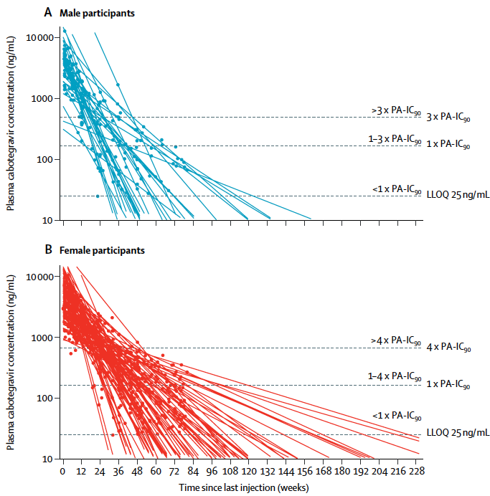
CAB LA PK tail
Phase 2a
134 HIV uninfected adults
LA CAB IM 800 mg 3 times at 12 weeks intervals or 600 mg 5 times (at one 4 week interval, and every 8 weeks thereafter)
Median delay between last CAB IM and time to plasma C < LLOQ
  longer in female than male (67.3 vs 43.7 weeks)
  longer if BMI ≥ 25 kg/m²
Risk of resistance during PK tail ?
When should we oral bridge ? Risk of d-d-i ?
Landovitz RL, Lancet HIV 2020;7:e472-81

Slide 32
New LA agent in existing class
MK-8507 (NNRTI)
Key Inclusion Criteria (NCT02174159)
• Plasma HIV-1 RNA ≥10,000 copies/mL
• CD4+ T-cell count >200/mm³
• ARV-naive
• No NNRTI drug resistance
• No active HCV/HBV infection
N = 6 per panel
In vitro IC5O = 51.3 nM
Mean T1/2 70 h, supports once-weekly dosing
Generally well tolerated with single doses up to 1200 mg and 3 x weekly 400 mg
Phase 2 study of MK-8507 (100 mg vs 200 mg vs 400 mg) with islatravir (20 mg), both QW, ongoing
Single Oral Doses of MK-8507 Reduced
HIV-1 RNA levels for at Least 1 Week
LS Mean Change in Plasma HIV-1 RNA
from Baseline at 7 Days Post-Dose,
log₁₀ copies/ml (95% CI)
0,5
MK-8507 600 mg (N=6)
MK-8507 80 mg (N=6)
MK-8507 (600 mg) | MK-8507 (80 mg) | MK-8507 (40 mg)
N=6 | N=6 | N=6
-1.53 (-1.84, -1.23) | -1.50 (-1.80, -1.19) | -1.22 (-1.52, -0.91)
0,0
MK-8507 40 mg (N=6)
Target Reduction in HIV-1 RNA
-0,5
Median change in Plasma HIV-1 RNA
from baseline, log₁₀ copies/mL (±SD)
-1,0
-1,5
-2,0
-2,5
0
4
24
96
120
144
168
Time, hours
Ankrom W, Glasgow 2020, Abs. 0416

Slide 33
New LA agents –new classes
Lenacapavir (capsid inhibitor)
  New MOA
  Single sc dose achieves > 2 log₁₀ c/mL HIV RNA decrease at Day 10
  Oral T1_{/2} ≈ 12 days ; sc T1_{/2} : 7 to 11 weeks
  3 oral lead-in doses followed by Q6M sc
  Good safety profile (phase 1 and 2a) : moderate ISR, grade 1 (80%), Headache 30 %, No grade ≥ 2 AE
Islatravir (Nucleoside RT Translocation Inhibitor)
  Antiviral activity against viruses resistant to approved NRTIs
  Half-life > 128 hours
  Potential for LA oral or sc
    ISL QW oral in combo with QW MK-8507

Slide 34
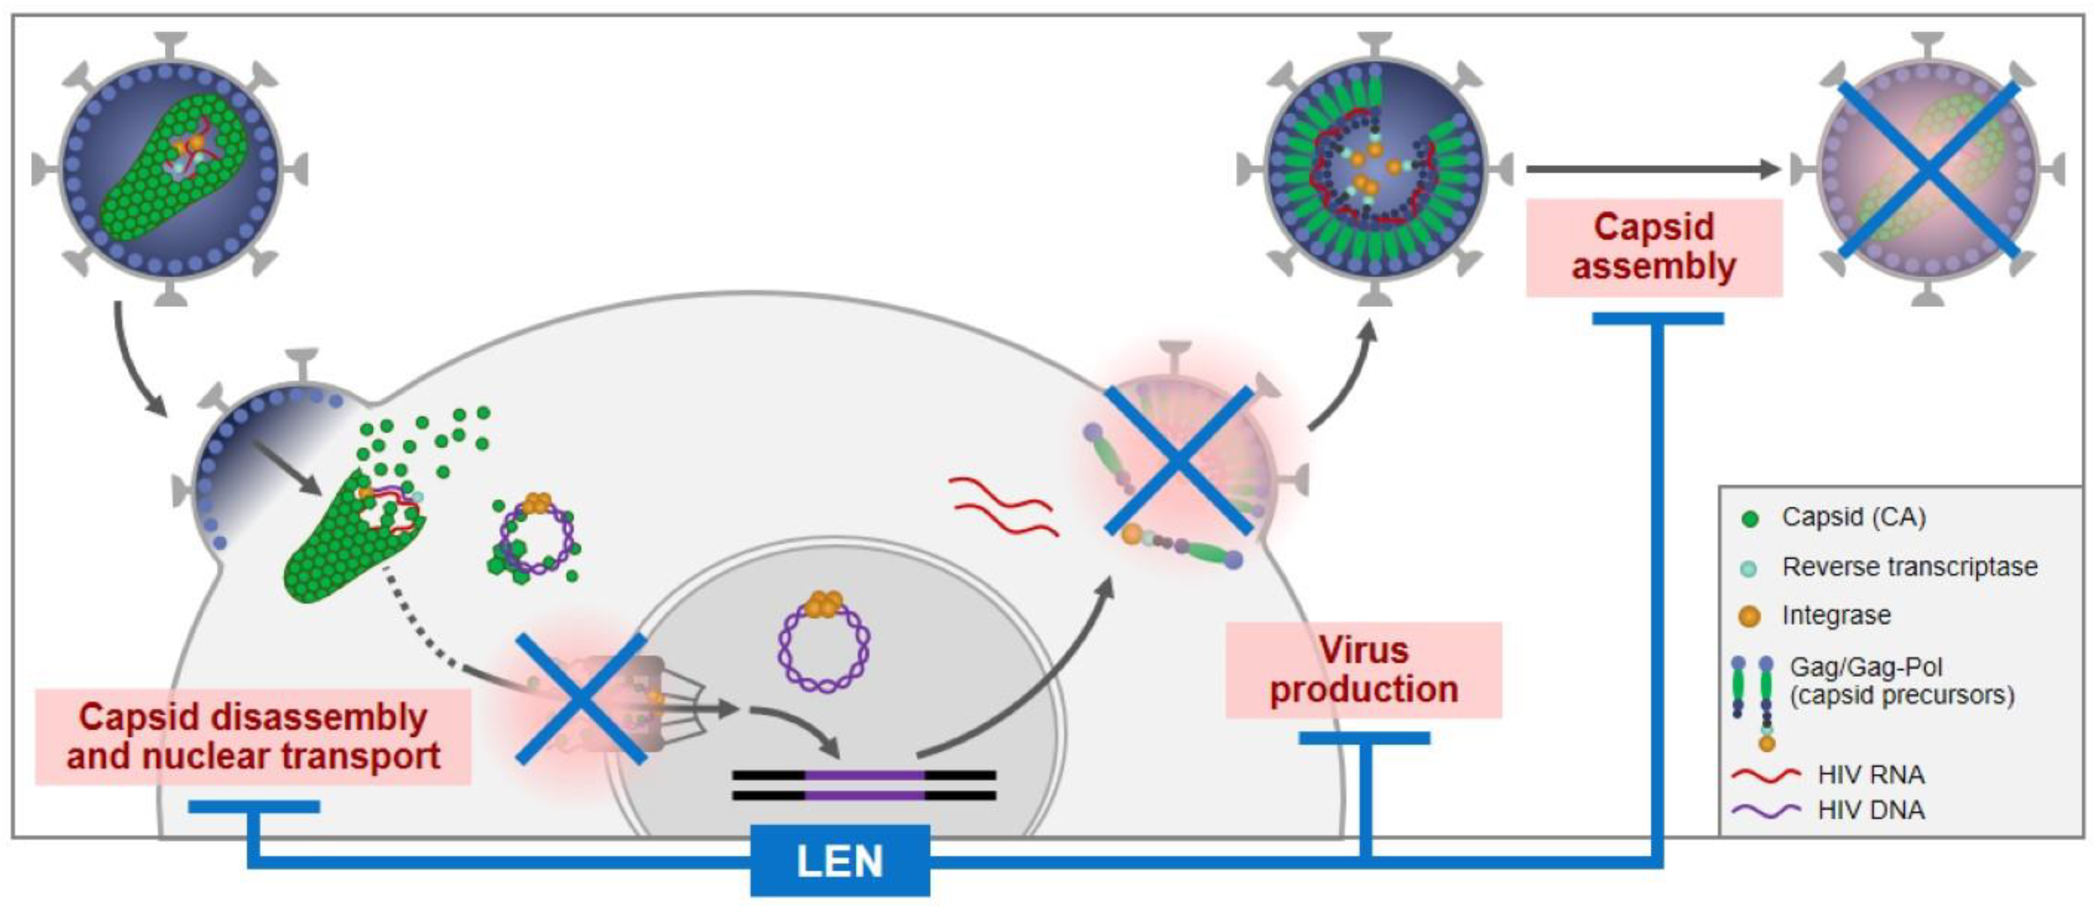
LEN: first-in-class HIV capsid inhibitor
LEN binds between 2 adjacent CA monomers
LEN binding alters assembly / diassembly of CA core (multi-stage effect)

Slide 35
Lenacapavir – Dosing schedule
Putting oral and SC together
Predicted LEN PK for Phase 2/3 LEN regimen
Dose
600 mg
300 mg
900 mg
900 mg
900 mg
100
100
10
10
6-fold paEC95 (IQ6)
LEN, ng/mL (90% CI)
Oral loading/lead-in
SC Q6M
1
1
0,1
0,1
1
2
4
8
12
15
26
52
Time Post-dose, days
Time Post-dose, days
Begley R, IAC 2020, Abs. PEB0265

Slide 36
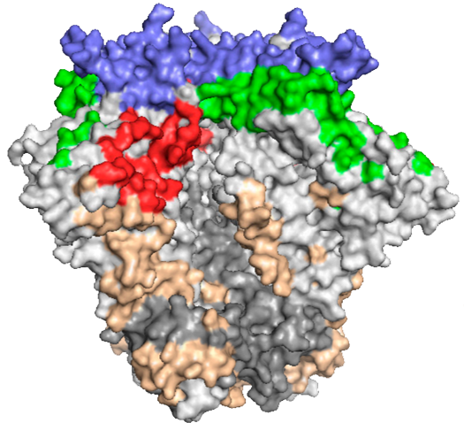
Broadly neutralizing monoclonal antibodies against HIV
V1/V2
CD4-binding site
b12, VRC01, VRC07, NIH45-46,
3BNC117, VRC-PG04
V3/Asn332 glycan
patch
CD4-binding site
V1/V2
PG9, PG16, CH01-04,
PGT141-145, PGDM1400
Phase 2 studies in HIV infected patients
Clear antiretroviral activity
Combinations will be necessary for treatment
Can be modified for longer half-life
Every 3 to 6 month infusions possible
Cellular targets (e.g. ibalizumab, UB-421)
V3/Asn332 glycan patch
PGT121-123, PGT125-131,
PGT135, 10-1074, 2G12
gp120/gp41
interface
gp120/gp41 interface
PGT151, 35O22, 8ANC195
MPER
MPER
2F5, 4E10, 10E8
Viral membrane
Tri-specific antibody

Slide 37
LA combo for salvage?
In MDR treatment experienced patients: optimal goal is at least 2
and preferably 3 active ARVs
Potential candidates
  ISL qw or monthly oral
  MK85-07 qw oral
  Lenacapavir Q6M sc (after oral lead-in)
  CAB LA IM? / Dolutegravir Ultra-long acting (preclinical)
  TAF implant (preclinical)
  Long acting monoclonal antibodies (IV)
  Ibalizumab (Q2W iv)
Pragmatic trial based on treatment history, cumulative genotype, adherence and psychological issues

Slide 38
Gilead and Merck
March 15, 2021 press release
Gilead and Merck Announce Agreement to Jointly Develop and Commercialize Long-Acting, Investigational Treatment Combinations of Lenacapavir and Islatravir in HIV
Collaboration to Focus on Oral and Injectable Formulations of Lenacapavir and Islatravir
Agreement Brings Together Potentially Complementary Medicines in Late-Stage
Development with the Goal to Provide Innovative, Long-Acting Treatments in HIV

Slide 39
Will LA ARVs change the PrEP paradigm ?
TDF/FTC every day or on demand ≈ 100% protection in high risk MSM
TAF/FTC non inferior
Barriers:
  forgetfulness
  competing priorities
  safety concerns
  stigma
  partners’ negative feelings toward PrEP
  uptake and coverage suboptimal

Slide 40
HPTN 083 Study: CAB LA IM versus TDF/FTC oral for PrEP
Design
STEP 1
STEP 2
STEP 3
Incidence of HIV/100 patient-years
Every day for
5 weeks
Every 2 months for
approximately 3 years
Every day
for 1 year
39 infections
CAB
Weeks 5 and 9
1.8
1.22
TDF/FTC
1.6
TDF/FTC
1.4
Randomisation
1:1
(Every day)
1.2
1.0
12 infections
Every day for
5 weeks
0.8
0.37
Every 2 months for
approximately 3 years
Weeks 5 and 9
0.6
CAB
0.4
TDF/FTC
0.2
3 204 PY
3 187 PY
(Everyday)
0.0
CAB
(N=2 241)
TDF/FTC
(N=2 247)
TDF/FTC
TDF/FTC pill
CAB injection
TDF/FTC
Placebo for TDF/FTC pill
CAB
CAB pill
Placebo for
CAB injection
CAB
Placebo for CAB pill
Landovitz R, IAC 2020, Abs. OAXLB01

Slide 41

PrEP Study for Women in Sub-Saharan Africa
Screening day
and informed
consent
STEP 1
STEP 2
STEP 3
Cabotegravir LA superior to oral TDF/FTC
with 89% reduction in HIV acquisition
Every day for
5 weeks
Every 2 months for
approximately 3 years
Every day
for 1 year
CAB
Weeks 5 and 9
 | Overall | CAB LA | TDF/FTC | Hazard Ratio (95% CI) CAB v TDF/FTC
Total Participants Enrolled | 3223 | 1613 | 1610
No. HIV Events | 38 | 4 | 34
Person-Years | 3808 | 1912 | 1896
Incidence Rate | 1 | 0.21 | 1.79 | 0.11 (0.04, 0,32)
95% CI for incidence rate | [0.71, 1.37] | [0.06, 0.54] | [1.24, 2.51]
Group A
TDF/FTC
TDF/FTC
(Every day)
Group B
CAB
TDF/FTC
(Everyday)
TDF/FTC
TDF/FTC pill
CAB injection
TDF/FTC
Placebo for TDF/FTC pill
CAB
CAB pill
Placebo for
CAB injection
CAB
Placebo for CAB pill
ViiV and HPTN press releases Nov 9, 2020

Slide 42
ISL: monthly oral 60 mg dose for PrEP
ISL-TP concentration (pmol/10⁶ PBMC)
10²
Blue filled circles and error bars represent mean and standard deviation observed data following ISL 60 mg QM dose
Solid line represent the population PK model predicted median concentration.
Shaded area represent 95% prediction interval
10¹
10⁰
10⁻¹
PK threshold: 0.05 pmol I 106 PBMC cells
10⁻²
0
4
8
12
16
20
24
28
Time (weeks)
Monthly oral dose of ISL 60 mg is expected to maintain systemic ISL-TP concentrations above the PK threshold (target concentration obtained after 1st dose and maintained)
Phase 3 PrEP trial to Evaluate lSL as Once-Monthly Oral PrEP for Women at High Risk for Acquiring HIV-1
Patel M, CROI 2021, Abs. 087

Slide 43
ISL implant for yearly PrEP
ISL-TP concentration, pmol/10⁶ PBMC
Study in low-risk
HIV-negative
participants
(8 per dose)
Sub-dermal implant for 12 weeks
Most frequent AE : headache
48 mg
52 mg
56 mg
10^{0.5}
Implant
removal
Implant
removal
Implant
removal
10⁰
Mean profile
Min & Max observation
10^{-0.5}
10⁻¹
PK Threshold: 0.05 pmol/10⁶ cells
10^{-1.5}
10⁻²
0
2
4
6
8
10
12
14
16
18
20
0
2
4
6
8
10
12
14
16
18
20
0
2
4
6
8
10
12
14
16
18
20
Nominal time (weeks)
Conclusions
  Next-generation radiopaque 56 mg implant ISL-TP concentrations comparable to 62 mg from previous study
  Half-life after removal of implant similar to half-life of orally dosed ISL (t_{1/2} for 56 mg is ~ 198 hr)
Matthews R, CROI 2021, Abs. 088

Slide 44
ISL implant
Release rate higher with new formulation
90
80
48 mg phase 2 (34%)
70
52 mg phase 2 (36%)
60
55 mg phase 2 (37.5%)
50
Cumulative Rel %
56.3 mg phase 2 (38.3%)
40
48 mg P008
30
20
52 mg P008
10
56 mg P008
0
0
10
20
30
40
50
60
70
Weeks
Phase 2a study to start Q3-2021 ISL implant 48 mg vs 52 mg vs 56 mg vs placebo in adults with low risk of HIV
Phase 3 will target high risk individuals

Slide 45
Lenacapavir analogue (GS-CA1) as PrEP ?
GS-CA1 Protects from Repeat intrarectal SHIV Challenges
100
 | No. protected | Median weeks to infection (95% CIs) | Hazard ratio | P-value
GS-CA1 300 mg/kg | 5 / 8 | NR (17, -) | 0.038 | 0.0002
GS-CA1 150 mg/kg | 2 / 8 | 16 (11, -) | 0.141 | 0.0061
Placebo | 0 / 8 | 7.5 (2, 14) | 1
80
GS-CA1
300 mg/kg
60
GS-CA1
150 mg/kg
40
20
Placebo
0
0
5
10
15
20
25
Study week
Hazard ratios, p-values calculated using Cox regression model.
Bekerman E, CROI 2021, Abs. 717

Slide 46
LA ART - Final thoughts
New options for ART = Good news
  40 years after first description of AIDS, what a long way we have come !
  Ultimately lethal disease to chronic asymptomatic status controlled with a single pill
  The road is now open for even more flexibility and new paradigms
  CAB LA + RPV LA IM paving the way for further progress
Challenges
  Further LA candidates: Need to demonstrate benefit with no extra safety or resistance emergence risk
  Implementation (Additional burden for heath care facilities)
  Acceptability
  Maximizing benefit (best candidates for LA?)
Gaps
  Chronic hepatitis B coverage
  Pregnant women or women of child bearing potential
  Prevention of vertical transmission
  Comedications with a potential of problematic drug-drug interaction (anticonvulsants, antimycobacterials)
  Management of potential severe toxicity
  How to rescue a case of unforeseen allergy or toxicity

Slide 47
Q/A

Slide 48
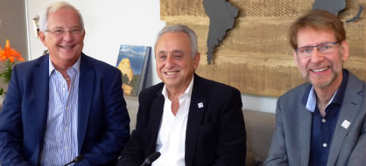

present:
LIVE WEBINAR
François Raffi
Nantes
France
Pedro Cahn
Buenos-Aires
Argentina
Anton Pozniak
London
United-Kingdom
Next webinar: Live AIDS 2021
Friday 27th July

Slide 49
present:
LIVE WEBINAR
François Raffi
Nantes
France
Pedro Cahn
Buenos-Aires
Argentina
Anton Pozniak
London
United-Kingdom
The speakers at this webinar thank you for your participation
Please complete the satisfaction questionnaire
(click on the questionnaire button in the chat)
If you missed part of this webinar,
you can watch the replay on:

